Slide 1
PENTACKLES

Slide 2
TEAM MEMBERS
COMPUTER SCIENCE (5A)
AAKANSHA TYAGI (2000290120001)
AAKRITI GUPTA (2000290120002)
AYUSH JAISWAL (2000290120052)
AYUSH TYAGI (2000290120056)

Slide 3
CONTENT
* INTRODUCTION
* OBJECTIVE
* PROBLEM STATEMENT
* TECHNOLOGY USED
* FLOWCHART
* FUTURE SCOPE
* CONCLUSION

Slide 4
INTRODUCTION
The system we have proposed is user friendly to get help and advice on health issues immediately through the online healthcare system.
This project includes a website which will predict the most possible diseases based on the given symptoms by the user and precautionary measures required to avoid the aggression of diseases.
This proposed website can predict the diseases such as Diabetes, Heart diseases, and Parkinson’s using machine learning.
The main motive of the proposed system is the prediction of the commonly occurring diseases in the early phase as when they are not checked or examined they can turn into a disease more dangerous disease and can even cause death.

Slide 5
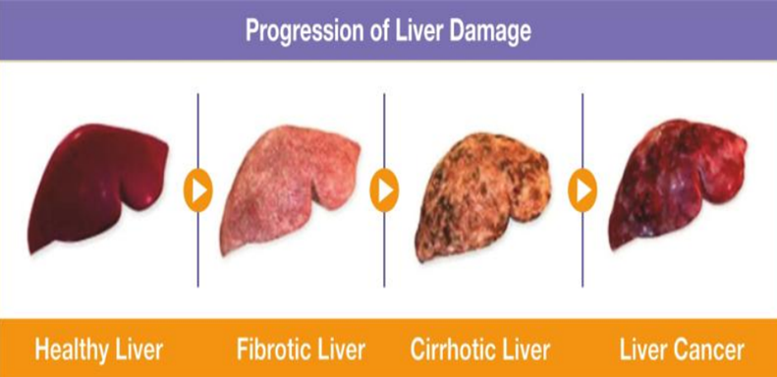

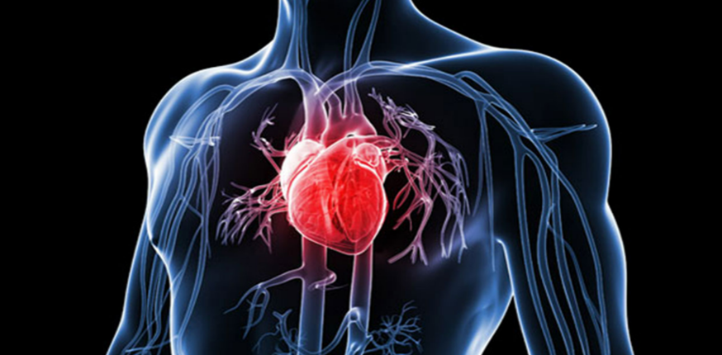
OBJECTIVE
This system is taking three diseases that are Liver disease , Diabetes, and Heart disease ,Parkinson’s. As all the three diseases are correlated to each other.
LIVER DISEASE DIABETES
HEART DISEASE

Slide 6
PROBLEM STATEMENT
Many of the existing machine learning models for health care analysis are concentrating on one disease per analysis.
If a user wants to predict more than one disease, he/she has to go through different sites.
There is no common system where one analysis can perform more than one disease prediction. Some of the models have lower accuracy which can seriously affect patients’ health.
When an organization wants to analyse their patient’s health reports, they have to deploy many models which in turn increases the cost as well as time Some of the existing systems consider very few parameters which can yield false results.
.

Slide 7
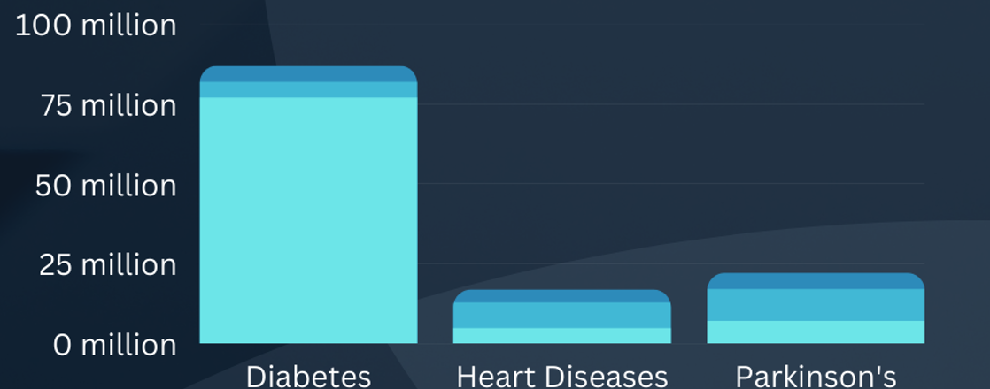
.
.
.

Slide 8





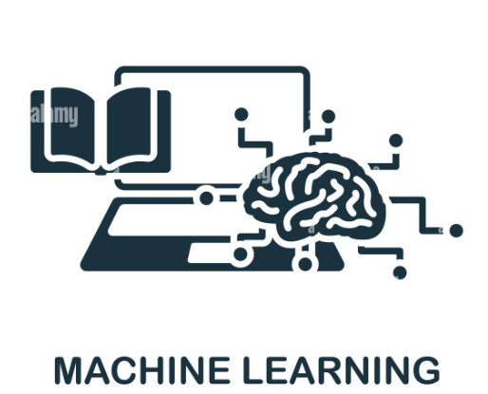

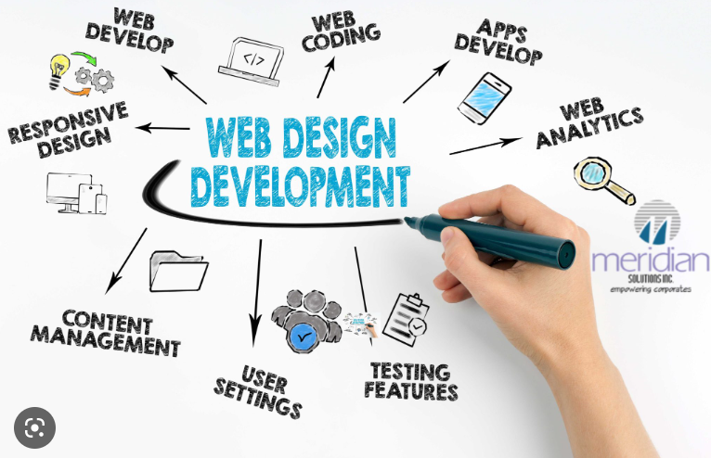
TECHNOLOGY USED
KNN ALGORITHM
RANDOM FOREST ALGORITHM
XG BOOST ALGORITHM
REACT JS
TAILWIND CSS
Disseminate standardized metrics
Coordinate e- business applications
Foster holistically superior methodologies
Deploy strategic networks with compelling e- business needs

Slide 9
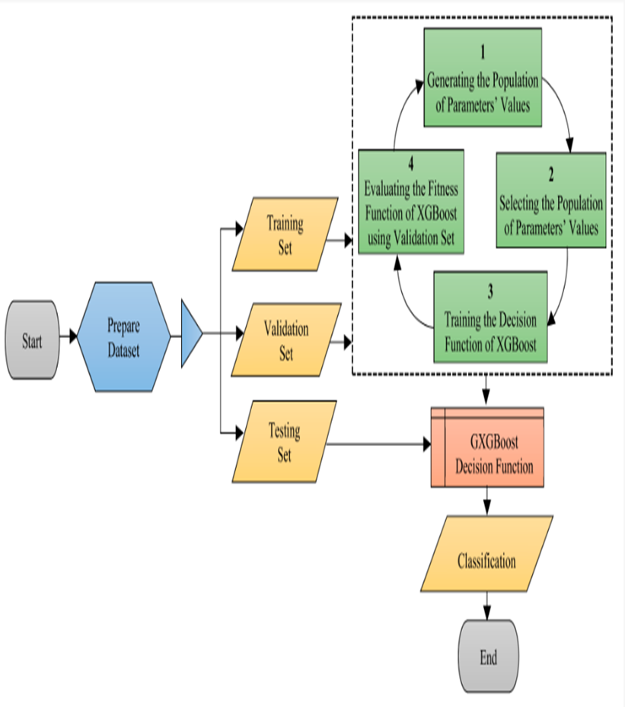
FLOWCHART
NOV 20XX
JAN 20XX
MAR 20XX
MAY 20XX
Synergize scalable e-commerce
Disseminate standardized metrics
Coordinate e- business applications
Foster holistically superior methodologies
Deploy strategic networks with compelling e- business needs

Slide 10

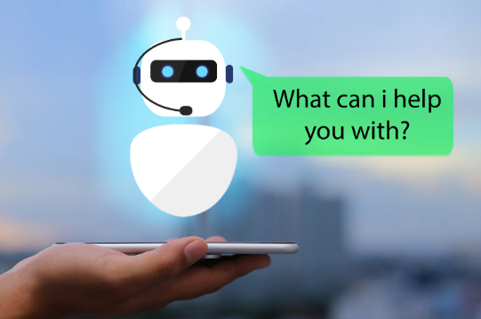

FUTURE SCOPE
In the future we can add more diseases in the existing API.
We can try to improve the accuracy of prediction in order to decrease the mortality rate.
We try to add chatbot for users so that the system work more efficiently.
.
.
.

Slide 11
CONCLUSION
This project was to create a system that would predict more than one disease and do so with high accuracy. Because of this project the user doesn’t need to traverse different websites which saves time as well.
Diseases if predicted early can increase your life expectancy as well as save you from financial troubles. For this purpose, we have used various machine learning algorithms like Random Forest, XG Boost, and K nearest neighbour (KNN) to achieve maximum accuracy.

Slide 12

THANK YOU
.

